Slide 1
Customer Churn Prediction Project
An analysis using Logistic Regression and Gradient Boosting

Slide 2
Introduction
Customer churn is a critical issue for Fintech companies as acquiring new customers is often more expensive than retaining existing ones. By predicting which customers are likely to churn, the company can implement targeted retention strategies to reduce churn rates and improve customer loyalty.

Slide 3
Exploratory Data Analysis (EDA)
Key Findings from EDA:
MonthlyCharges and TotalCharges are significant features influencing churn.
Customers with higher monthly charges are more likely to churn.
Longer tenure reduces the likelihood of churn.

Slide 4
Model Choice & Results
Two models were selected and tuned for optimal performance
Model tunning by GridSearchCV
1. Logistic Regression
Best parameters: C=0.1, penalty='l2', solver='lbfgs’
Accuracy: 64.5%
Precision: 67.4%
Recall: 60.7%
ROC AUC: 69.0%
2. Gradient Boosting
Best parameters: learning_rate=0.01, max_depth=5, min_samples_leaf=2, min_samples_split=10, n_estimators=200, subsample=0.9
Accuracy: 64.7%
Precision: 69.2%
Recall: 57.3%
ROC AUC: 68.8%

Slide 5
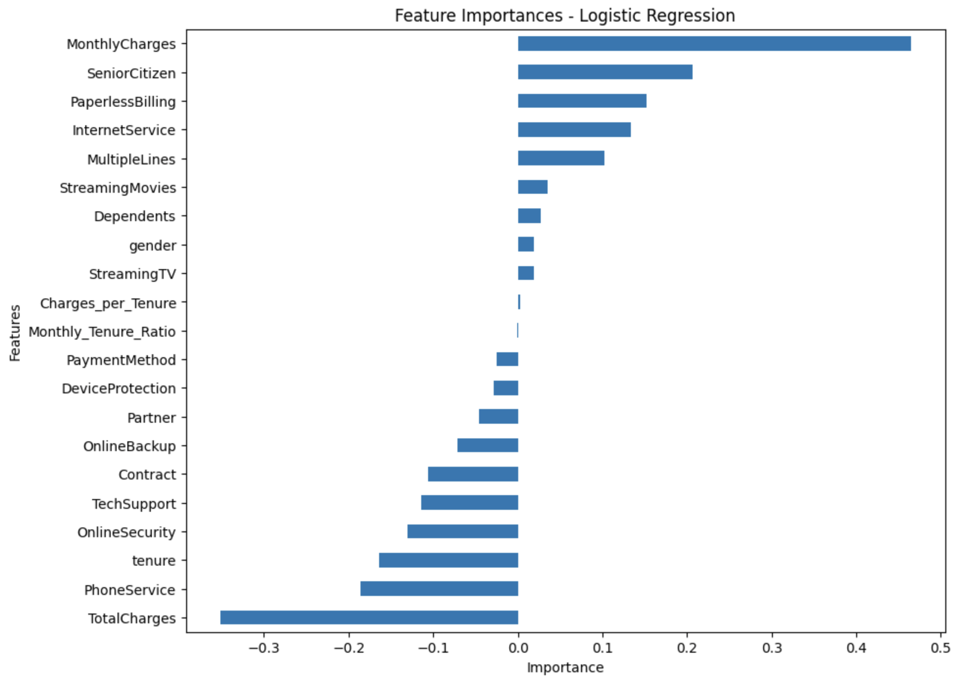
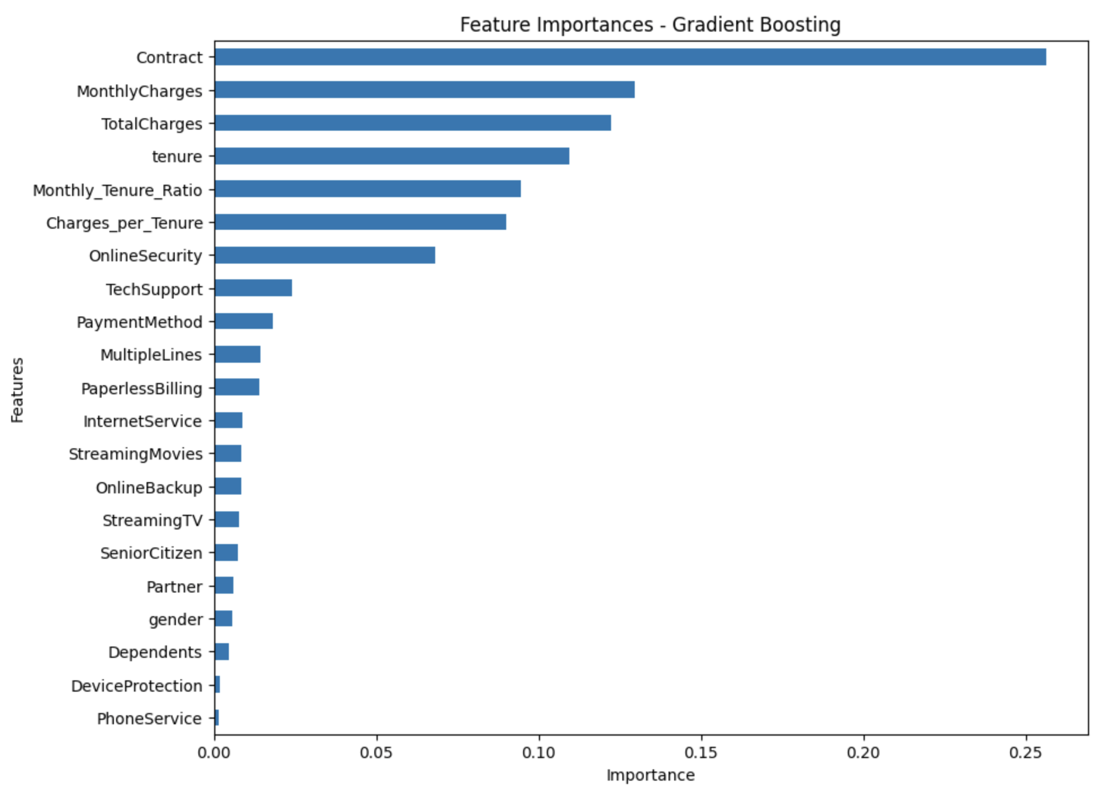
Results

Slide 6
Why These Models are the Best for the Client?
Logistic Regression
Simplicity and Interpretability
Good Balance of Precision and Recall: Precision of 67.4% and Recall of 60.7%
Gradient Boosting
Higher Precision (69.2%)
Better Handling of Complex Patterns

Slide 7
Questions and Answers
Thank you for your attention. We are now open for questions.

